Slide 1
Optimizing Waste Generation and Collection Adequacy in Istanbul Districts
Tevhidenur Serdar
Furkan Şahin
Burak Aydın

Slide 2
Agenda
Introduction
3
Problem Description
4
Method Formulation
5
Experiments
10
Summary
13

Slide 3
Introduction
3
Efficient waste management is crucial for public health and urban sustainability in Istanbul, where rapid growth has increased waste generation.
This study analyzes waste patterns across Istanbul's districts, evaluates current facilities, and predicts future trends.
The goal is to identify infrastructure gaps and propose strategic locations for new facilities to improve waste management efficiency and sustainability.

Slide 4



Problem Description
𝐷 represents Istanbul's districts, and 𝐹 represents waste facility locations.
𝑤_𝑑 denotes waste generated by district 𝑑.
𝑑_𝑑𝑓 is the distance between district 𝑑 and facility 𝑓.
𝑥_𝑑𝑓 is the proportion of waste from district 𝑑 collected by facility 𝑓.
Objective:
Minimize the total transportation cost
Subject to:
Proportional collection constraint
Proportion variable constraints

Slide 5



Method Formulation
1 - Collecting Data
Waste Data (IBB Open Data Platform)
Waste Facility Locations (IBB Open Data Platform)
Transfer Data (IBB Open Data Platform)
District Map (GitHub)

Slide 6
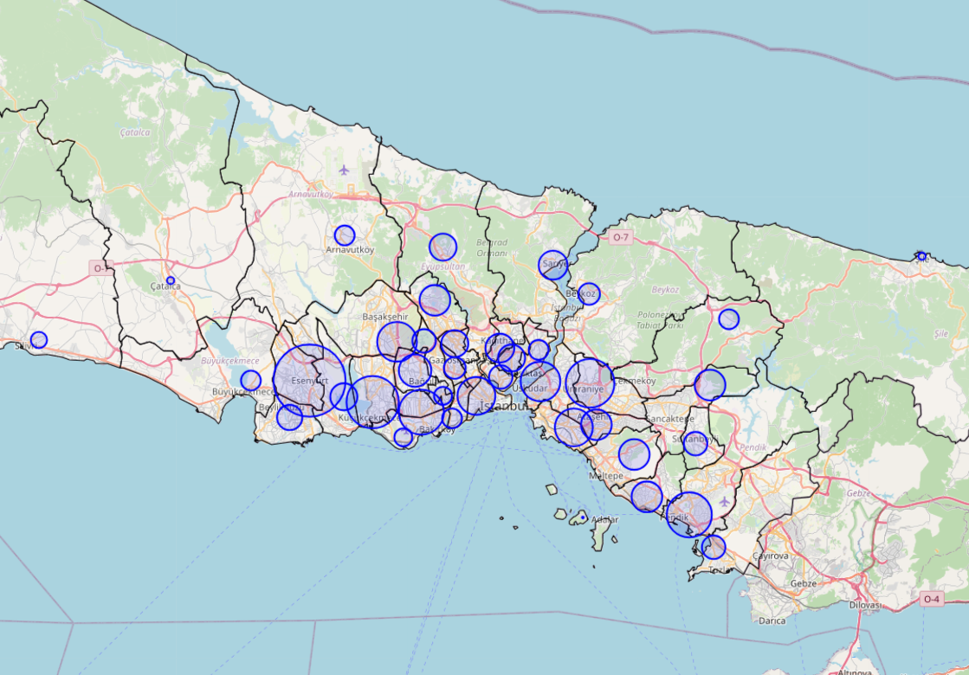
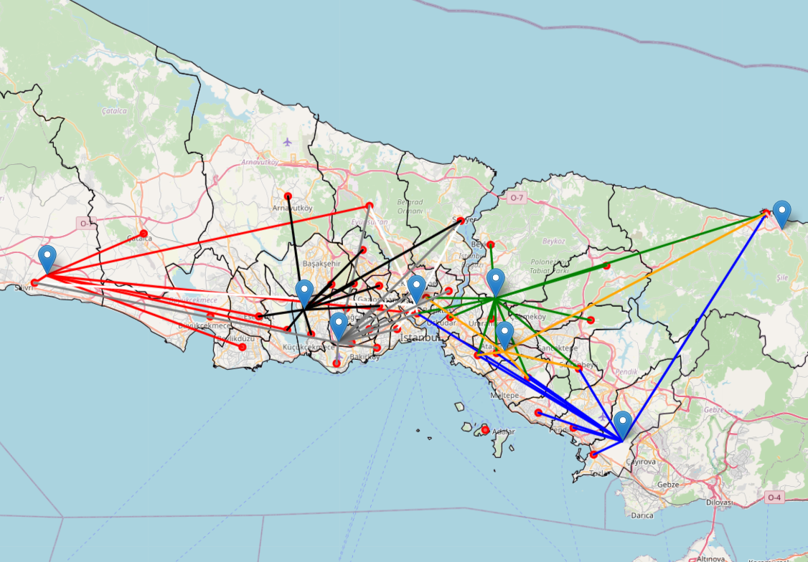
Method Formulation
2 - Visualization
Geographical distribution of waste generation
Routes from each district to the waste facilities

Slide 7
Method Formulation
3 - Forecasting
District | Waste (kg)
Esenler | 114,117
Beyoglu | 124,404
Atasehir | 140,647
Kagithane | 144,140
Kucukcekmece | 263,524
A polynomial regression model was used to forecast waste production for 2024 based on historical data.
SAMPLE FORECAST OF WASTE PRODUCTION FOR 2024 BY DISTRICT.

Slide 8
Method Formulation
4 – Genetic Algorithm
Generation | Best fitness | Location(Lati,Long)
0 | 14761.76 | (41.0693, 28.8919)
1 | 14761.76 | (41.0693, 28.8919)
... | ... | …
18 | 15053.52 | (41.0419, 28.8752)
19 | 15053.52 | (41.0419, 28.8752)
Objective:
Minimize transportation cost by optimizing the placement of a new waste transfer center in Istanbul.
Approach:
Used a genetic algorithm with a population of 20, running for 20 generations with a 50% mutation rate.
Results:
Converged to an optimal solution with coordinates (41.0419, 28.8752) for the new transfer center, offering the lowest transportation cost.

Slide 9
Experiments
If we change mutation rate:
Mutation rate | 0,1 | 0,5 | 0,9
Best location | [41.0417, 28.8816] | [41.0419, 28.8752] | [41.0454, 28.8814]
If we change population number:
Population | 4 | 10 | 20
Best location | [41.0530, 28.8612] | [41.0404, 28.8734] | [41.0419, 28.8752]
If we change generation number:
Generation | 4 | 10 | 20
Best location | [41.0364, 28.8765] | [41.0373, 28.8884] | [41.0419, 28.8752]

Slide 10
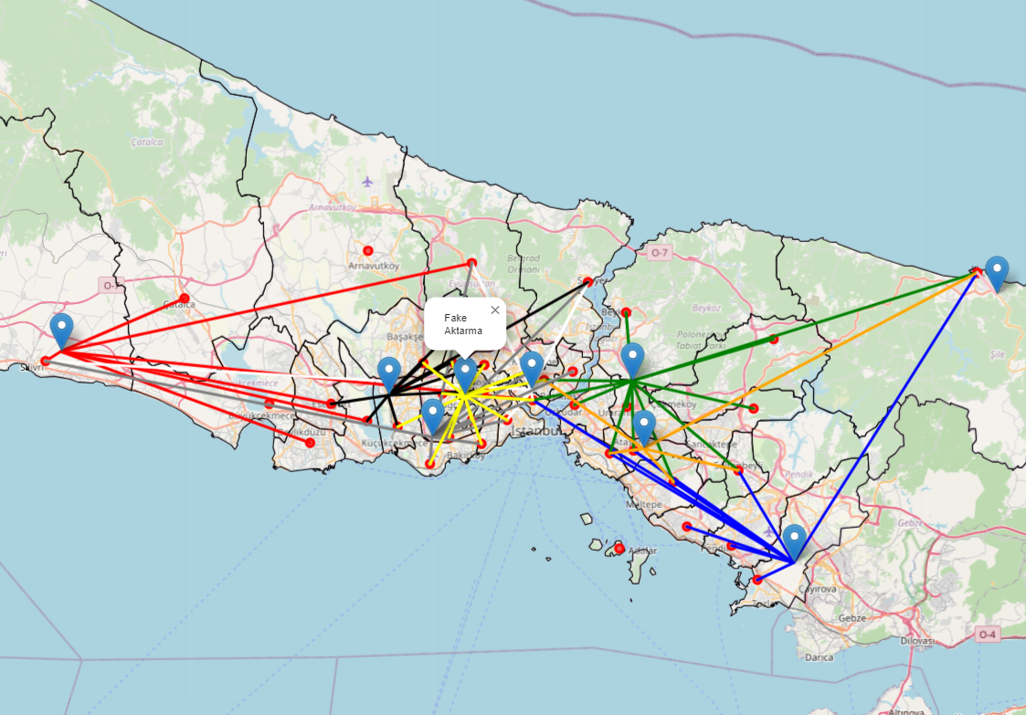
Optimized Waste Facility Placement

Slide 11
Summary
This study uses a genetic algorithm to optimize waste management in Istanbul, achieving effective placement of new facilities and route optimization.
The results demonstrate the feasibility and benefits of such methods for other megacities. Future work could focus on dynamic routing algorithms for further improvement.

Slide 12
Thank you

